Slide 1
SWE2005-SOFTWARE TESTING
Black Box Testing Strategies
Module 2
Dr. Shivani Gupta,
VIT Chennai

Slide 2
OUTLINE
What Is Black Box Testing ?
Types Of Black Box Testing
Black-Box Testing Techniques
Equivalence Partitioning
Boundary Value Analysis (BVA)
Decision table based Testing
Cause-Effect Graphing Based Testing
State Transition Testing
Error Guessing

Slide 3
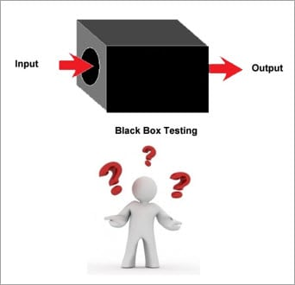
What Is Black Box Testing ?
Black Box Testing is also known as behavioral, opaque-box, closed-box, specification-based or eye-to-eye testing.
It is a Software Testing method that analyses the functionality of a software/application without knowing much about the internal structure/design of the item that is being tested and compares the input value with the output value.

Slide 4
Types Of Black Box Testing
Practically, there are several types of Black Box Testing that are possible but if we consider the major variant of it then below mentioned are the two fundamental ones.
#1) Functional Testing
This type deals with the functional requirements or specifications of an application. Here, different actions or functions of the system are being tested by providing the input and comparing the actual output with the expected output.
For Example, when we test a Dropdown list, we click on it and verify that it expands and all the expected values are showing in the list.

Slide 5
#2) Non-Functional Testing
Apart from the functionalities of the requirements, there are several non-functional aspects as well that are required to be tested to improve the quality and performance of the application.
Few major types of Non-Functional Testing include:
Usability Testing
Load Testing
Performance Testing
Compatibility Testing
Stress Testing
Scalability Testing

Slide 6
Black Box Testing Techniques
In order to systematically test a set of functions, it is necessary to design test cases. Testers can create test cases from the requirement specification document using the following Black Box Testing techniques.
Equivalence Partitioning
Boundary Value Analysis
Decision Table Testing
State Transition Testing
Error Guessing
Graph-Based Testing

Slide 7
Equivalence Partitioning Techniques
This technique is also known as Equivalence Class Partitioning (ECP). In this technique, input values to the system or application are divided into different classes or groups based on its similarity in the outcome.
Hence, instead of using each and every input value we can now use any one value from the group/class to test the outcome. In this way, we can maintain the test coverage while we can reduce a lot of rework and most importantly the time spent.

Slide 8
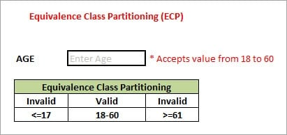
Example:
As present in the above image, an “AGE” text field accepts only the numbers from 18 to 60. There will be three sets of classes or groups.
Two invalid classes will be:
a) Less than or equal to 17.
b) Greater than or equal to 61.
One valid class will be anything between 18 to 60.
We have thus reduced the test cases to only 3 test cases based on the formed classes thereby covering all the possibilities. So, testing with anyone value from each set of the class is sufficient to test the above scenario.

Slide 9
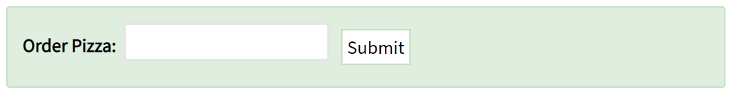
Practice Question
Let's consider the behavior of Order Pizza Text Box Below:
"Only 10 Pizza can be ordered"
Pizza values 1 to 10 is considered valid. A success message is shown.
While value 11 to 99 are considered invalid for order and an error message will appear,

Slide 10
Here is the test condition
Any Number greater than 10 entered in the Order Pizza field(let say 11) is considered invalid.
Any Number less than 1 that is 0 or below, then it is considered invalid.
Numbers 1 to 10 are considered valid
Any 3 Digit Number say -100 is invalid.
We cannot test all the possible values because if done, the number of test cases will be more than 100. To address this problem, we use equivalence partitioning hypothesis where we divide the possible values of tickets into groups or sets as shown below where the system behavior can be considered the same.

Slide 11
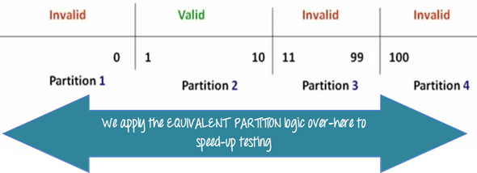

Slide 12
Boundary Value Analysis
From the name itself, we can understand that in this technique we focus on the values at boundaries as it is found that many applications have a high amount of issues on the boundaries.
Boundary means the values near the limit where the behavior of the system changes. In boundary value analysis both the valid inputs and invalid inputs are being tested to verify the issues.

Slide 13
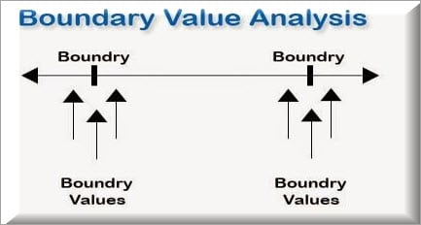
For Example:
If we want to test a field where values from 1 to 100 should be accepted then we choose the boundary values: 1-1, 1, 1+1, 100-1, 100, and 100+1. Instead of using all the values from 1 to 100, we just use 0, 1, 2, 99, 100, and 101.

Slide 14
Practice Question
Let's consider the behavior of Order Pizza Text Box Below:
"Only 10 Pizza can be ordered"
Pizza values 1 to 10 is considered valid. A success message is shown.
While value 11 to 99 are considered invalid for order and an error message will appear,

Slide 15
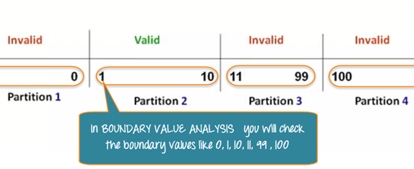

Slide 16
Why Equivalence & Boundary Analysis Testing
This testing is used to reduce a very large number of test cases to manageable chunks.
Very clear guidelines on determining test cases without compromising on the effectiveness of testing.
Appropriate for calculation-intensive applications with a large number of variables/inputs

Slide 17
Decision Table Testing
Decision table testing is a software testing technique used to test system behavior for different input combinations.
This is a systematic approach where the different input combinations and their corresponding system behavior (Output) are captured in a tabular form.
That is why it is also called as a Cause-Effect table where Cause and effects are captured for better test coverage.

Slide 18
As the name itself suggests that, wherever there are logical relationships like:
If { (Condition = True) then action1 ; } else action2; /*(condition = False)*/
Then a tester will identify two outputs (action1 and action2) for two conditions (True and False). So based on the probable scenarios a Decision table is carved to prepare a set of test cases.

Slide 19
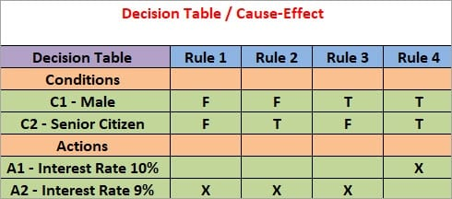
Example 1:
Take an example of XYZ bank that provides interest rate for the Male senior citizen as 10% and for the rest of the people 9%.
In this example condition, C1 has two values as true and false, condition C2 also has two values as true and false. The number of total possible combinations would then be four. This way we can derive test cases using a decision table.

Slide 20
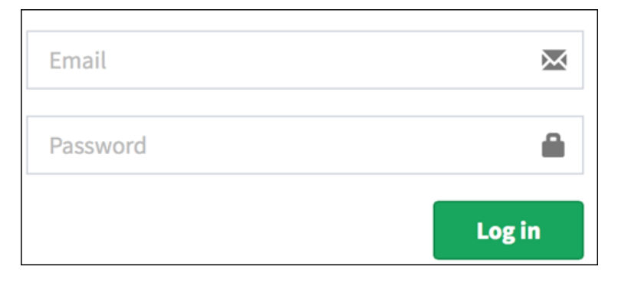
Example 2: How to make Decision Base Table for Login Screen
Let's create a decision table for a login screen.

Slide 21
The condition is simple if the user provides correct username and password the user will be redirected to the homepage. If any of the input is wrong, an error message will be displayed.
T – Correct username/password
F – Wrong username/password
E – Error message is displayed
H – Home screen is displayed
Interpretation:
Case 1 – Username and password both were wrong. The user is shown an error message.
Case 2 – Username was correct, but the password was wrong. The user is shown an error message.
Case 3 – Username was wrong, but the password was correct. The user is shown an error message.
Case 4 – Username and password both were correct, and the user navigated to homepage

Slide 22
Decision Table
Conditions | Rule 1 | Rule 2 | Rule 3 | Rule 4
Username (T/F) | F | T | F | T
Password (T/F) | F | F | T | T
Output (E/H) | E | E | E | H

Slide 23
Practice Question
Consider a Banking application that will ask the user to fill a personal loan application online. Based on the inputs, the application will display real-time whether the loan will get approval, rejection, or requires a visit to the branch for further documentation and discussion. Let’s assume that the loan amount is 5L. In addition to this, we won’t change it to reduce the complexity of this scenario.
Accordingly, the application has the following business rules:
If you are Salaried and your Monthly Salary is greater than or equal to 75k, then your loan will be approved.
If you are Salaried and your Monthly Salary is between 25k and 75k, then you will need to visit the branch for further discussion.

Slide 24
If you are Salaried and your Monthly Salary is less than 25k, then your loan will be rejected.
If you are Not Salaried and your Monthly Salary is greater than or equal to 75k, then you will need to visit the branch for further discussion.
If you are Not Salaried and your Monthly Salary is less than 75k, then your loan will be rejected, consequently.

Slide 25
Solution
Step 1 – Identify all possible Conditions
Consequently, the possible conditions are as below:
First, whether the person is Salaried or not.
Second, Monthly Salary of the applicant.

Slide 26
Step 2 – Identify the corresponding actions that may occur in the system
Therefore, the possible actions are:
Should the loan be approved (Possible values Y or N)
Should the loan be rejected (Possible values Y or N)
Should the applicant be called for further documentation and discussion (Possible values Y or N)

Slide 27
Step 3 – Generate All possible Combinations of Conditions
Each of these combinations forms a column of the decision table. Firstly, let’s see how many variations are possible for each condition:
Condition 1 – Whether the person is salaried or not – 2 Variations: Y or N
Condition 2 – Monthly Salary of the Applicant – 3 Variations : <25k , 25k – 75k and >75k

Slide 28
Subsequently, based on this our total combinations will come up as 2*3 = 6
1st Combination : Salaried = Yes , Monthly Salary < 25k
2nd Combination: Salaried = Yes, Monthly Salary 25k – 75k
3rd Combination: Salaried = Yes, Monthly Salary >75k
4th Combination : Salaried = No , Monthly Salary < 25k
5th Combination: Salaried = No, Monthly Salary 25k – 75k
6th Combination: Salaried = No, Monthly Salary >75k

Slide 29
CONDITIONS | Combination # 1 | Combination # 2 | Combination # 3 | Combination # 4 | Combination # 5 | Combination # 6
Salaried? | Y | Y | Y | N | N | N
Monthly Income < 25k | Y | NA | NA | Y | NA | NA
Monthly Income 25k – 75k | NA | Y | NA | NA | Y | NA
Monthly Income >75k | NA | NA | Y | NA | NA | Y
ACTIONS
Loan Approved | NA | NA | Y | NA | NA | NA
Loan Rejected | Y | NA | NA | Y | Y | NA
Further Documentation & Visit | NA | Y | NA | NA | NA | Y

Slide 30
Why is Decision Table Testing is important?
This testing technique becomes important when it is required to test different combination.
The significance of this technique becomes immediately clear as the number of inputs increases.
Number of possible Combinations is given by 2 ^ n , where n is the number of Inputs. For n = 10, which is very common in the web based testing, having big input forms, the number of combinations will be 1024. Obviously, you cannot test all but you will choose a rich sub-set of the possible combinations using decision based testing technique.

Slide 31
Question
A program reads three number A, B and C with a range [1,50] and prints the largest number. Design test cases for this program using equivalence class testing technique.

Slide 32
Solution 1
Partition the domain of input as valid values and invalid values, getting the following classes:
C1={1<=A<=50}
C2={1<=B<=50}
C3={1<=C<=50}
C4={A<1}
C5={A>50}
C6={B<1}
C7={B>50}
C8={C<1}
C9={C>50}

Slide 33
Test Cases
Test Case ID | A | B | C | Expected result | Classes Covered
1 | 13 | 25 | 36 | C is largest | C1, C2, C3
2 | 0 | 13 | 45 | Invalid Input | C4
3 | 51 | 34 | 17 | Invalid Input | C5
4 | 29 | 0 | 18 | Invalid Input | C6
5 | 36 | 53 | 32 | Invalid Input | C7
6 | 27 | 42 | 0 | Invalid Input | C8
7 | 33 | 21 | 51 | Invalid Input | C9

Slide 34
Solution 2
C1={A>B, A>C}
C2={B>A, B>C}
C3={C>A, C>B}
C4={A=B, A≠C}
C5={B=C, A≠B}
C6={A=C, C≠B}
C7={A=B,=C}

Slide 35
Test Cases
Test Case ID | A | B | C | Expected result | Classes covered
1 | 25 | 13 | 13 | A is largest | C1, C5
2 | 25 | 40 | 25 | B is largest | C2, C6
3 | 24 | 24 | 37 | C is largest | C3, C4
4 | 25 | 25 | 25 | Equal | C7

Slide 36
Practice Question
1. A program determines the next date in the calendar. Its input is entered in the form of ddmmyyyy with following range:
1<= mm <= 12
1 <=dd <= 31
1900 <= YYYY<=2025
Its output would be the next date or erorr msg invalid date.
Design test cases using equivalence class partitioning method.

Slide 37
2. A program calculated the total salary of an employee with conditions that if the working hours less than or equal to 8, then give normal salary. The hours over 8 on normal working days are calculated at the rate of 1.25 of the salary. However, on holidays or Sundays, the hours are calculated at the rate of 2.00 times of the salary. Design the test cases using decision table testing.

Slide 38
State Transition Testing
State Transition Testing is a technique that is used to test the different states of the system under test.
The state of the system changes depending upon the conditions or events. The events trigger states which become scenarios and a tester needs to test them.
A systematic state transition diagram gives a clear view of the state changes but it is effective for simpler applications.

Slide 39
States
New State
Ready
Running
Waiting
Terminated

Slide 40
When to use?
When we have sequence of events that occur and associated conditions that apply to those events
When the proper handling of a particular event depends on the events and conditions that have occurred in the past
It is used for real time systems with various states and transitions involved

Slide 41
State Transition Model has four basic parts:
The states that the software may occupy (open/closed or funded/insufficient funds);
The transitions from one state to another (not all transitions are allowed);
The events that cause a transition (closing a file or withdrawing money);
The actions that result from a transition (an error message or being given your cash).

Slide 42
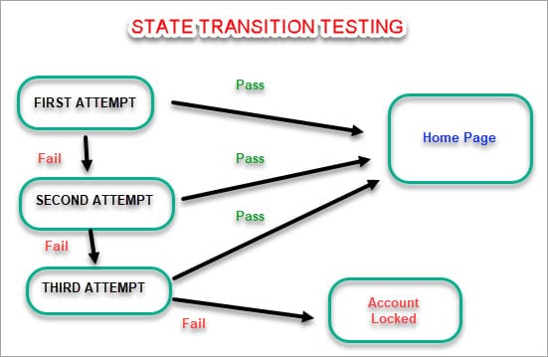
For Example: Login Page

Slide 44
Graph-Based Testing
Each and every application is a build-up of some objects. All such objects are identified and the graph is prepared.
From this object graph, each object relationship is identified and test cases are written accordingly to discover the errors.

Slide 46
Advantages and Disadvantages
Advantages
The tester need not have a technical background. It is important to test by being in the user's shoes and think from the user’s point of view.
Testing can be started once the development of the project/application is done. Both the testers and developers work independently without interfering in each other’s space.
It is more effective for large and complex applications.
Defects and inconsistencies can be identified at the early stage of testing.
Disadvantages
Without any technical or programming knowledge, there are chances of ignoring possible conditions of the scenario to be tested.
In a stipulated time there are possibilities of testing less and skipping all possible inputs and their output testing.
A Complete Test Coverage is not possible for large and complex projects.

Slide 47
Error Guessing
This is a classic example of Experience-Based Testing.
In this technique, the tester can use his/her experience about the application behavior and functionalities to guess the error-prone areas. Many defects can be found using error guessing where most of the developers usually make mistakes.
Few common mistakes that developers usually forget to handle:
Divide by zero.
Handling null values in text fields.
Accepting the Submit button without any value.
File upload without attachment.
File upload with less than or more than the limit size.

